Slide 2
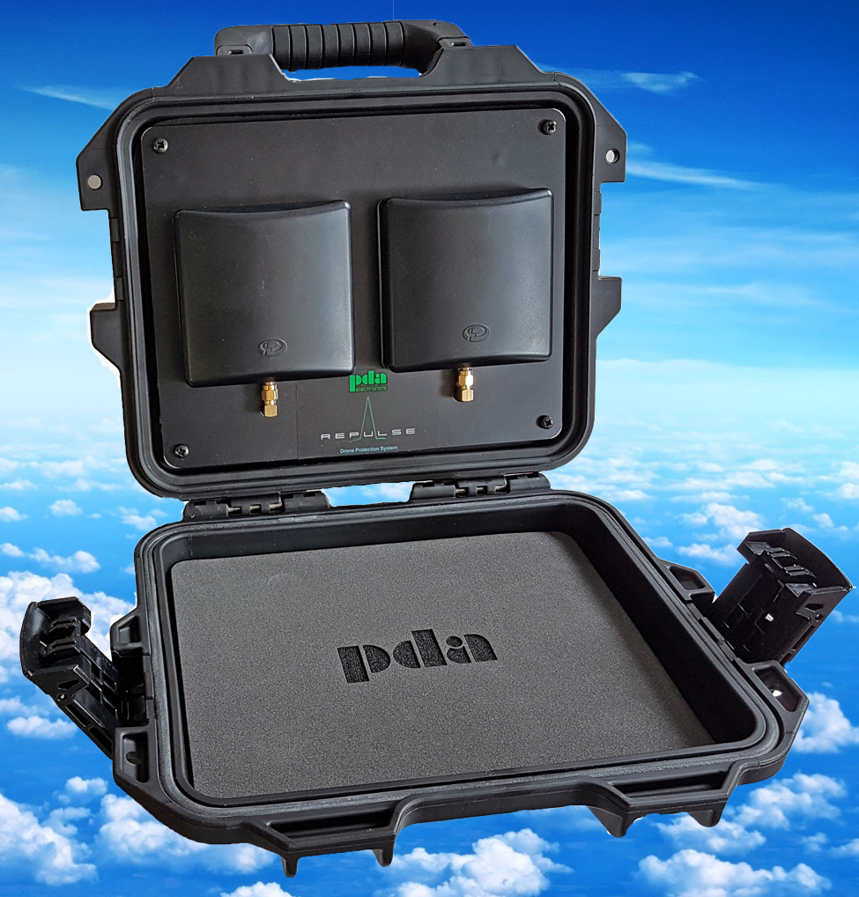
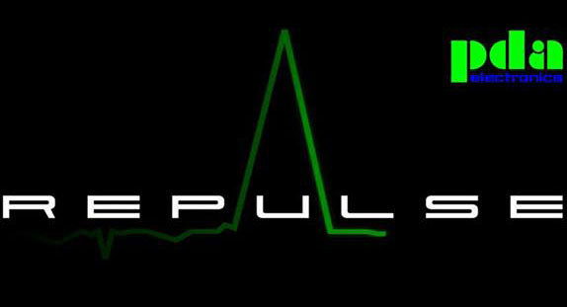
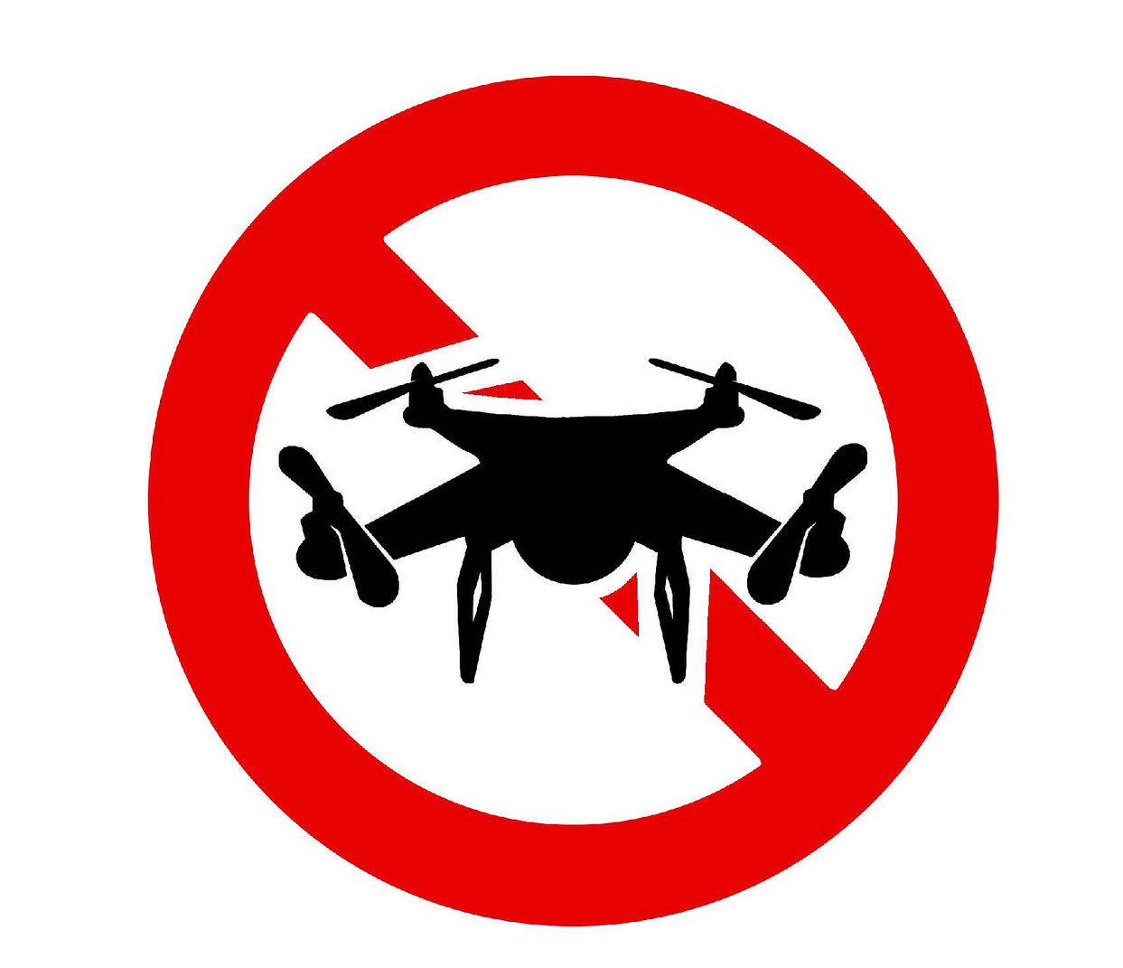
What is Repulse®?
Repulse is a drone protection system.
Repulse DOES NOT rely on detection.
Repulse comes in many different styles.
Repulse does not affect existing communications.
Preventing drone access

Slide 3
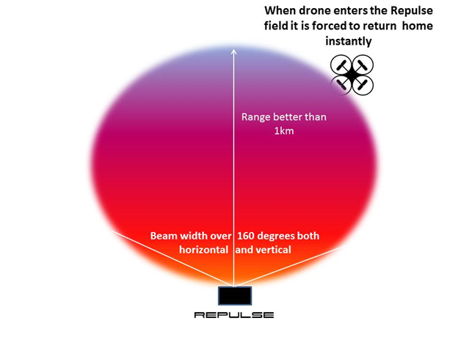
How does Repulse® work?
Repulse creates an electronic no fly zone in excess of 1 km (depending on the antenna).
Repulse interferes with the drones control frequencies forcing it to invoke it’s safety protocol (go home).
When Repulse is turned on the electronic no fly zone is impenetrable by any drone using 2.4GHz and 5.8GHz.
The unit can be powered by a 6800Ah Li-ion battery or a 12v DC mains power supply.
With the patch antenna the area covered is 160° horizontally and vertically in excess of 1km.

Slide 4
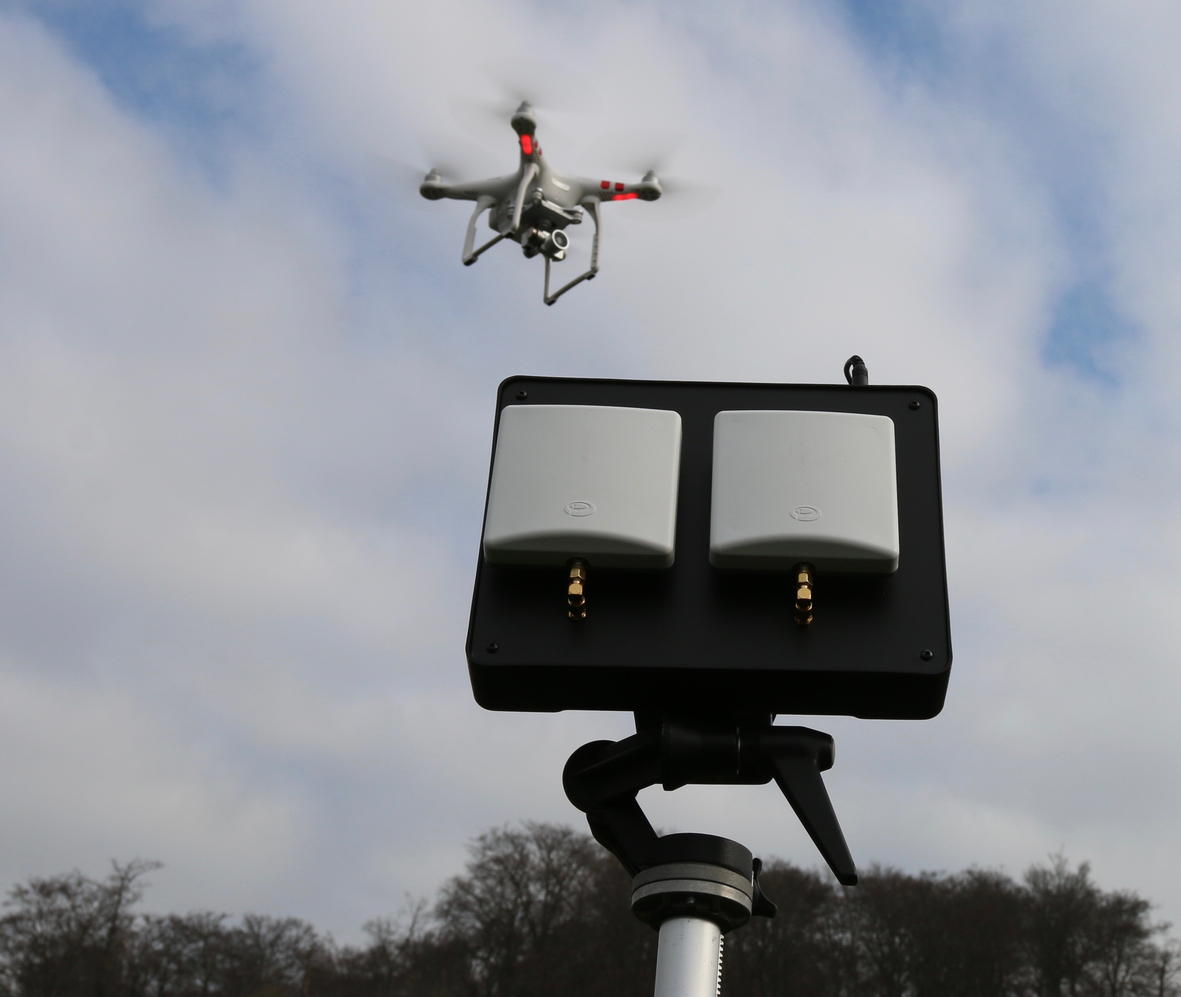
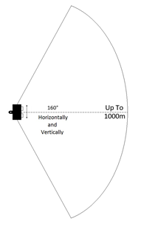
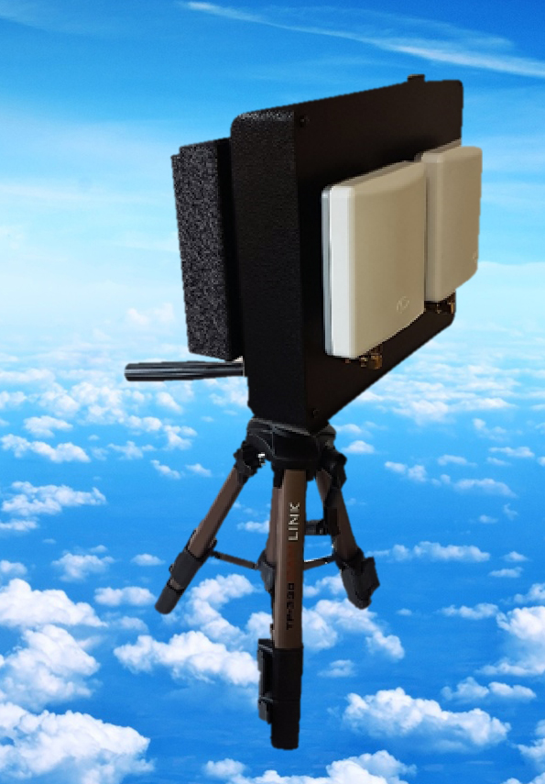
The different Repulse® units
2458H (handheld)
The handheld unit is a rapid deployment unit.
Weight is just 1.5kg.
Using a 6800ah battery can be operated for approximately 4-6 hours (depending on power setting).
Can be powered by a 12v DC mains power supply to allow 24hr use.
Average power per band is -30dBm (1µw).
Operating range in excess of 1km vertically and horizontally.
Comes complete with ¼” whitworth thread for tripod mount.

Slide 5
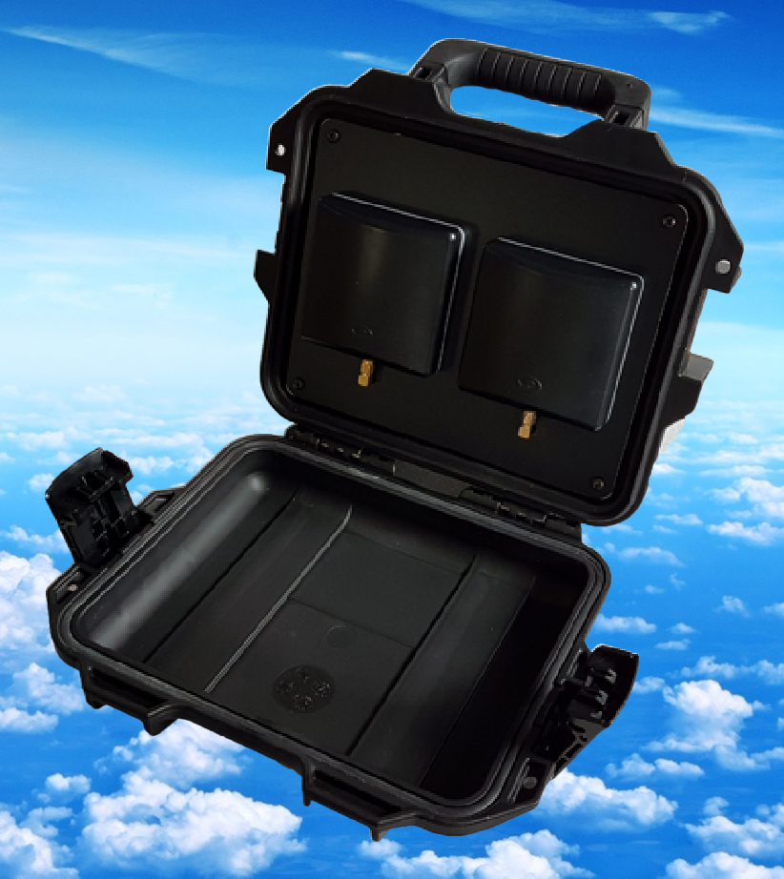
2458E (ruggedized)
The 2458E is another rapid deployment unit.
Enclosed in an ATA300 certificated peli case.
Weight is 2.5kg.
Powered by an internal 6800ah battery can run for approx. 4-6 hours (depending on power setting).
Can also be powered by a 12V DC mains power supply to enable 24hr use.
Average power per band -30dBm (1µw).
Operating range is in excess of 1km vertically and horizontally.

Slide 6
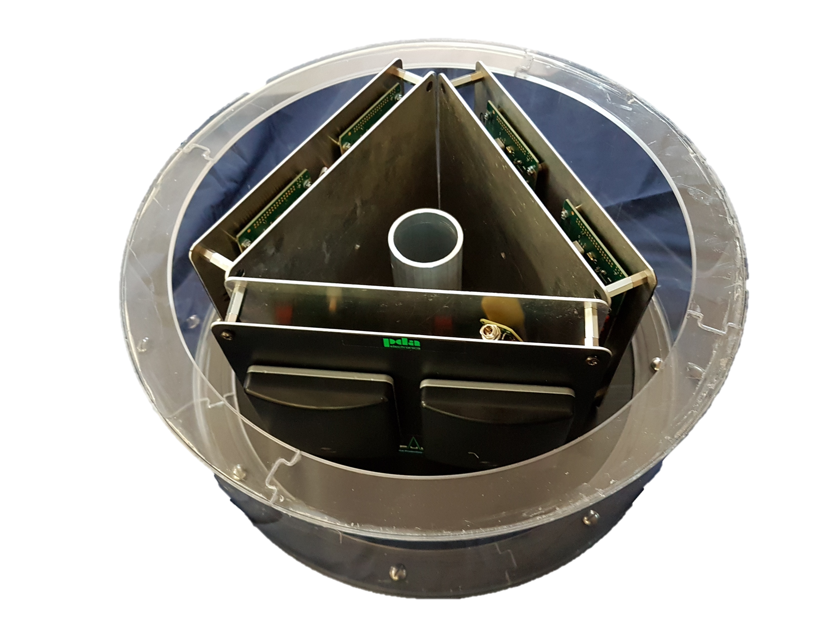
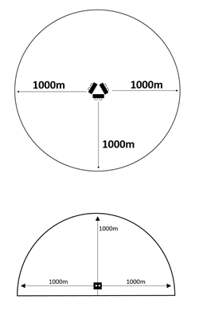
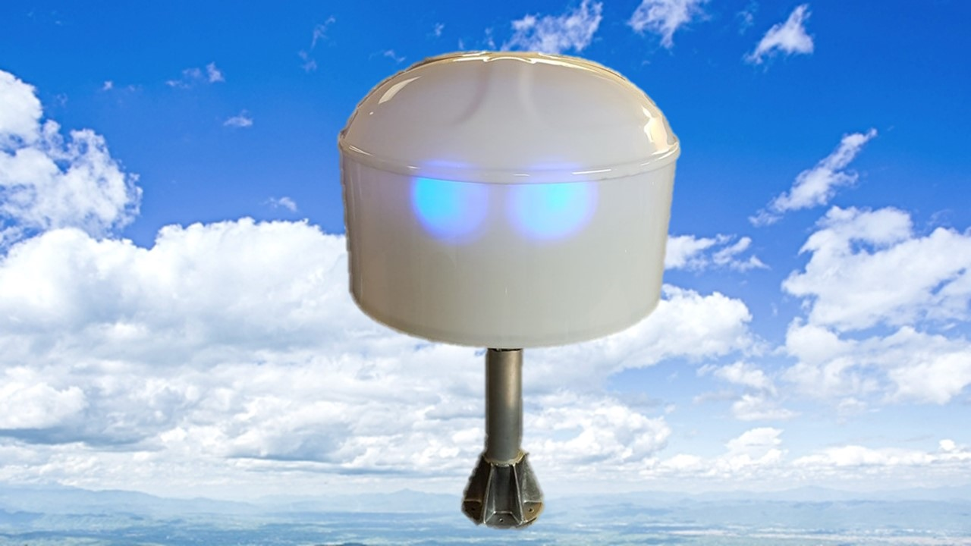
Repulse® 360
Repulse® 360 is a permanent pole mounted unit.
It consists of 3 units mounted in a triangle giving a full 360° protection.
Powered by a 12V DC mains power supply.
Operating range in excess of 1km from unit vertically and horizontally.
Total area covered is in excess of 2km diameter.
Average power per band -30dBm (1µw).

Slide 7
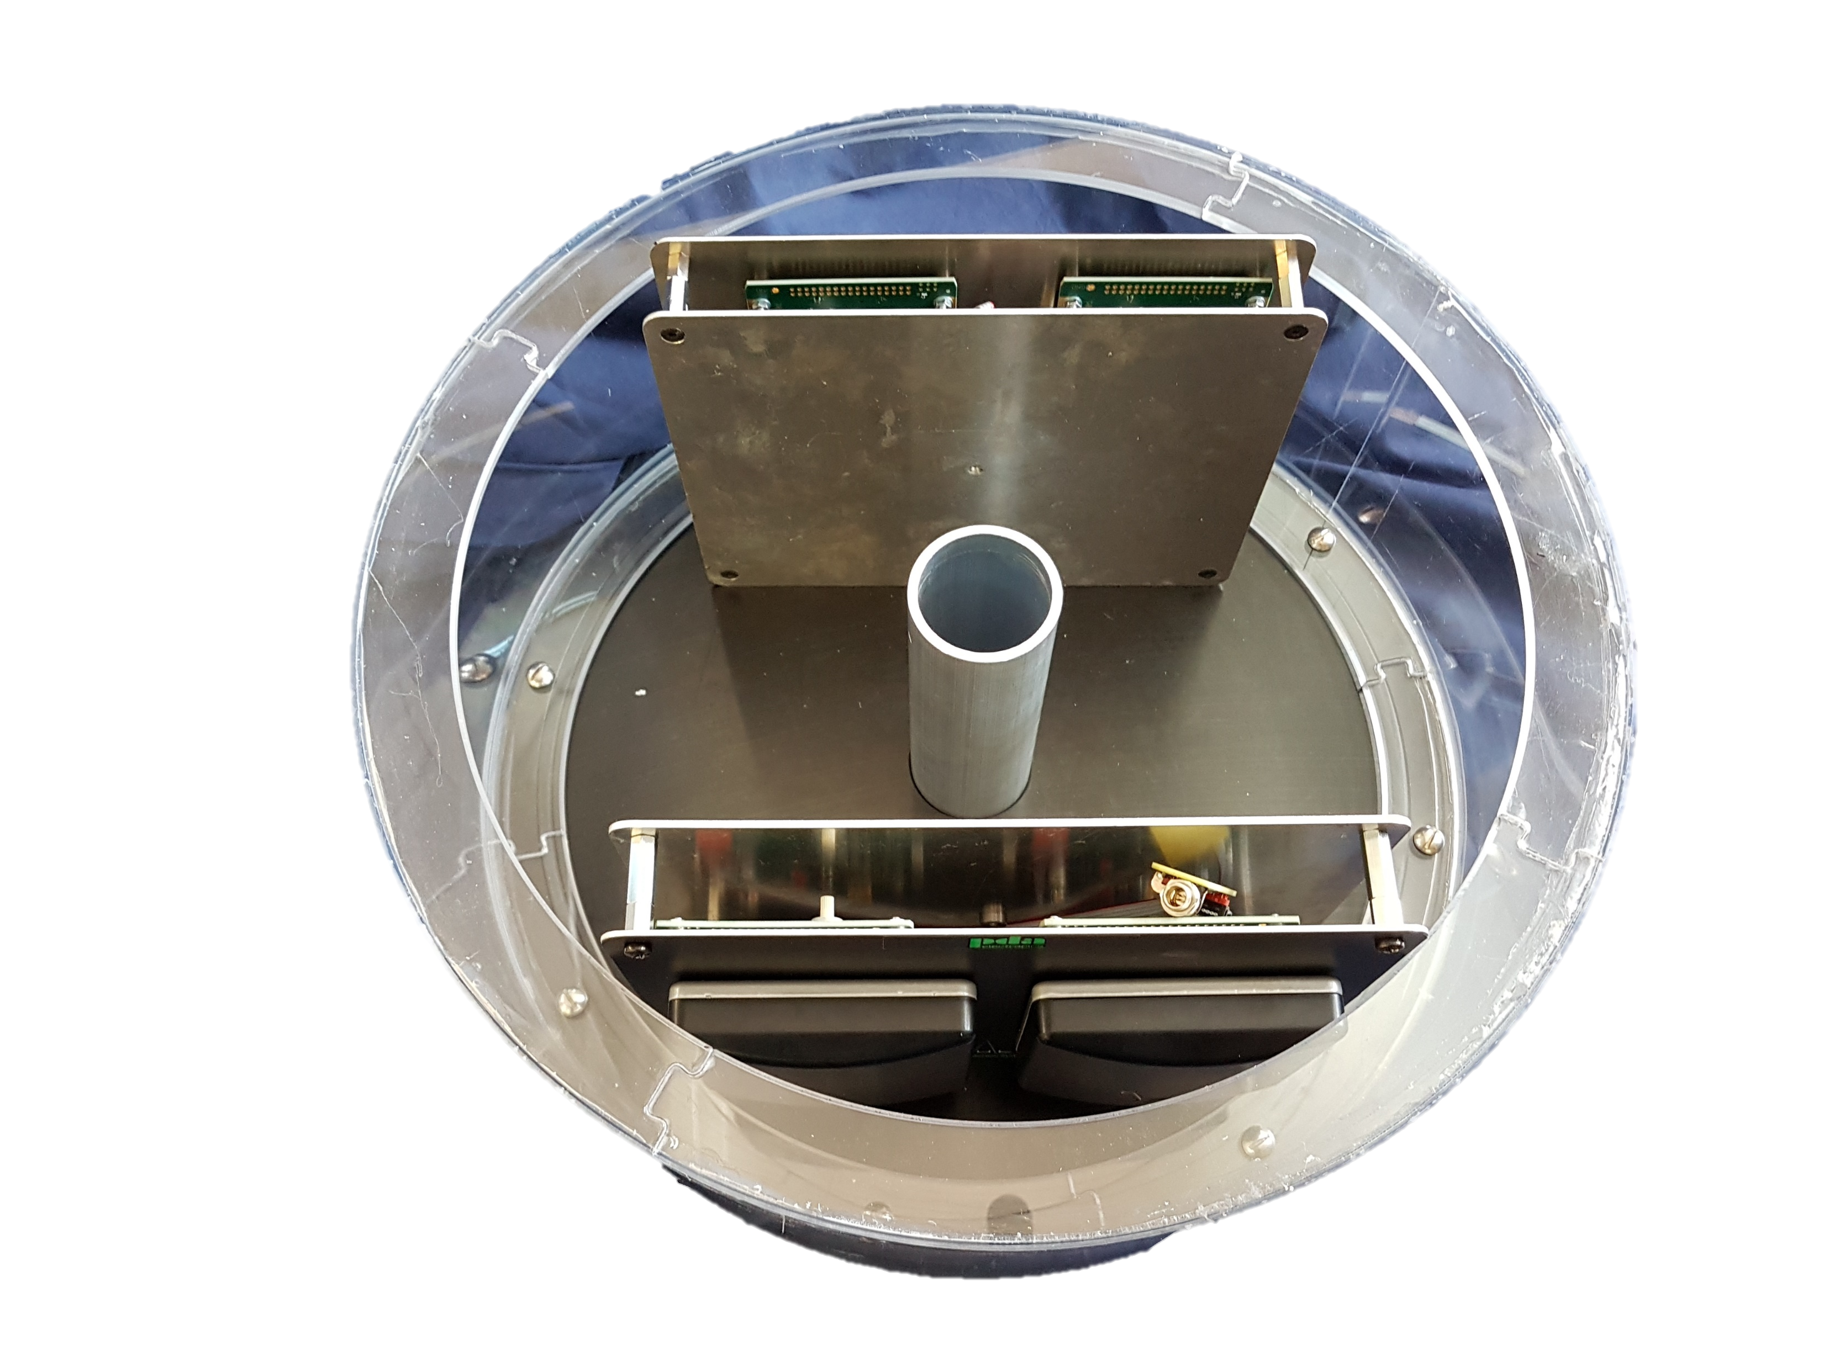
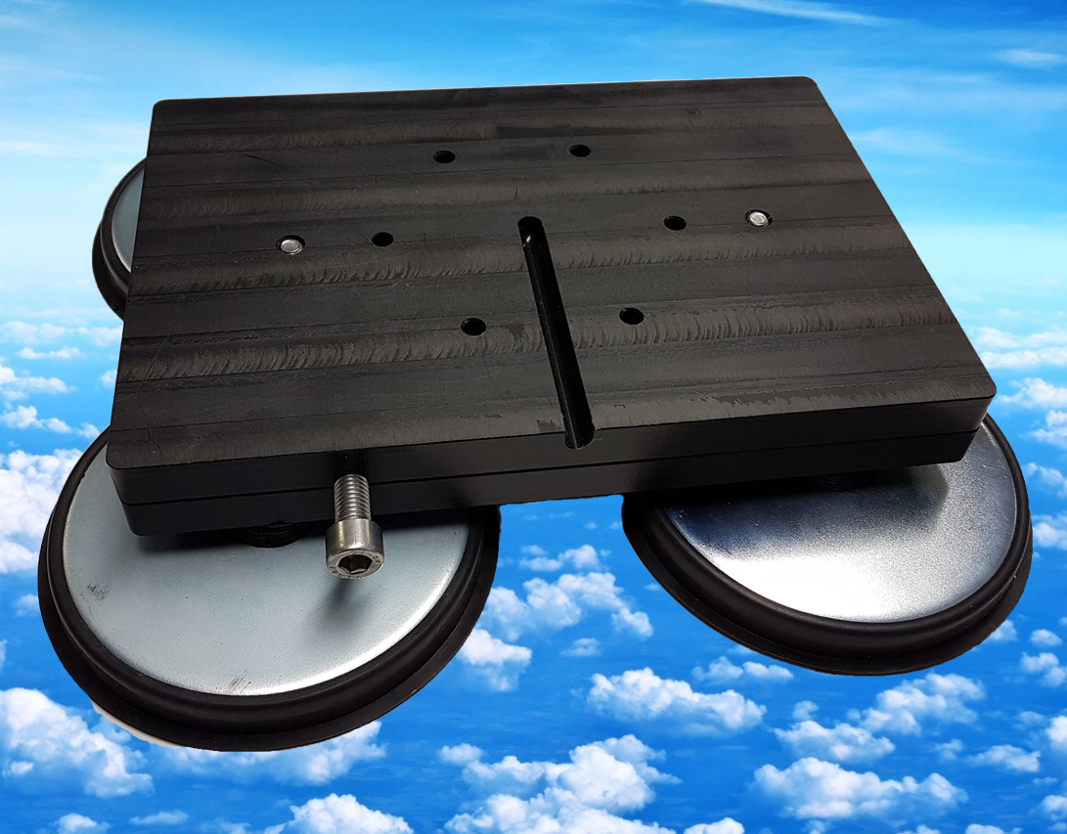
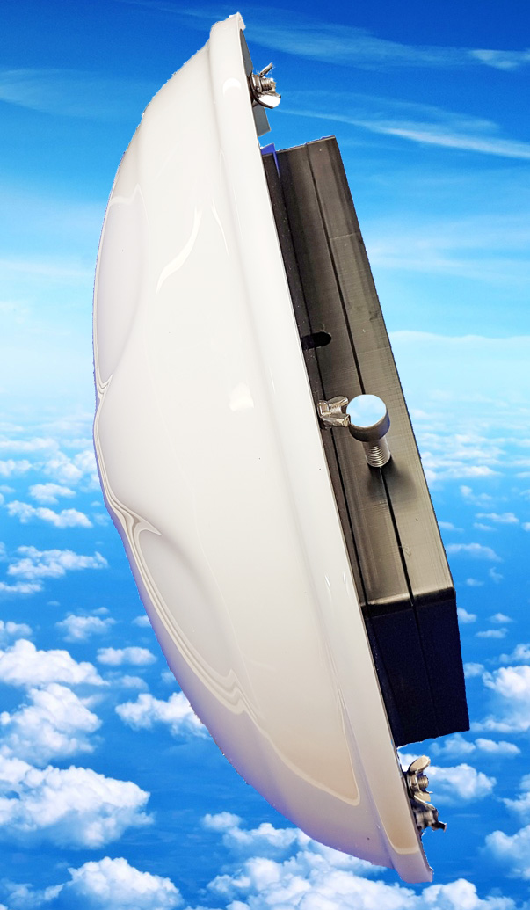
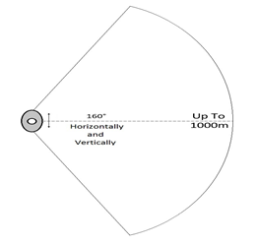
Repulse® 160 & 320
The Repulse 160 is a single unit mounted inside an aerodynamic molding.
The Repulse 320 is two units mounted back to back inside an aerodynamic molding giving approximately 320° protection.
Powered by 12v DC mains power supply.
Operating range in excess of 1km each way units are facing.
Average power per band is -30dBm (1µw).
The Repulse 160 can be wall mounted with our special bracket or fitted to a car with our magnetic mount.

Slide 8
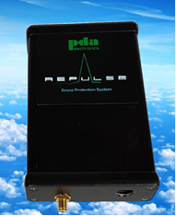
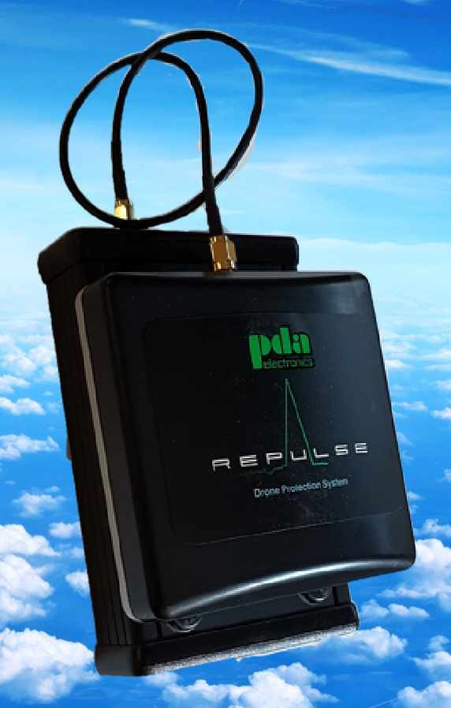
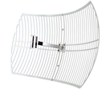
Repulse® 24
Repulse® 24 has many different applications.
Rapid deployment on security vests
Permanent mount at airfields.
It only utilizes the 2.4GHz frequency which is the main control frequency.
It can be used to protect aircraft on take off and landing.
Can be put in the front of aircraft using a patch antenna.

Slide 9
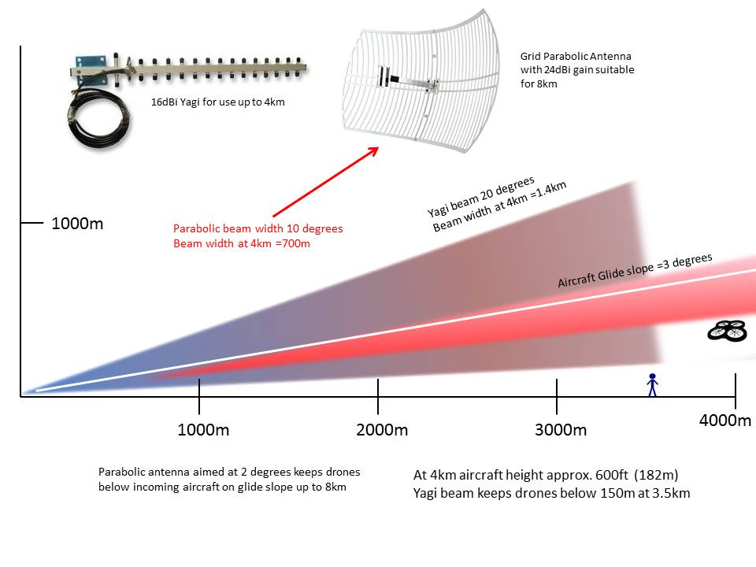
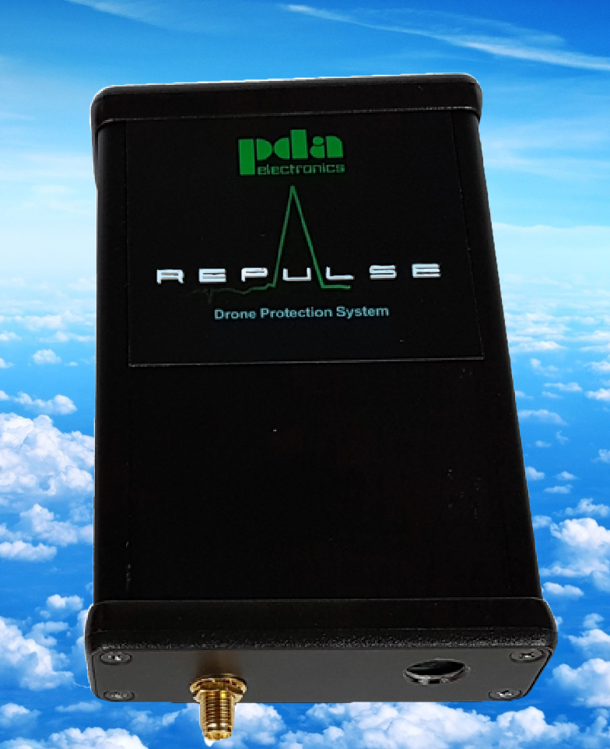
Protecting aircraft on landing
Using the Repulse 24 with different antennas for distance.
Angled on the glide slope to give protection from drones wanting that closer look.

Slide 10
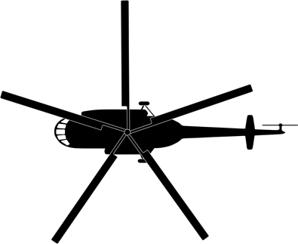
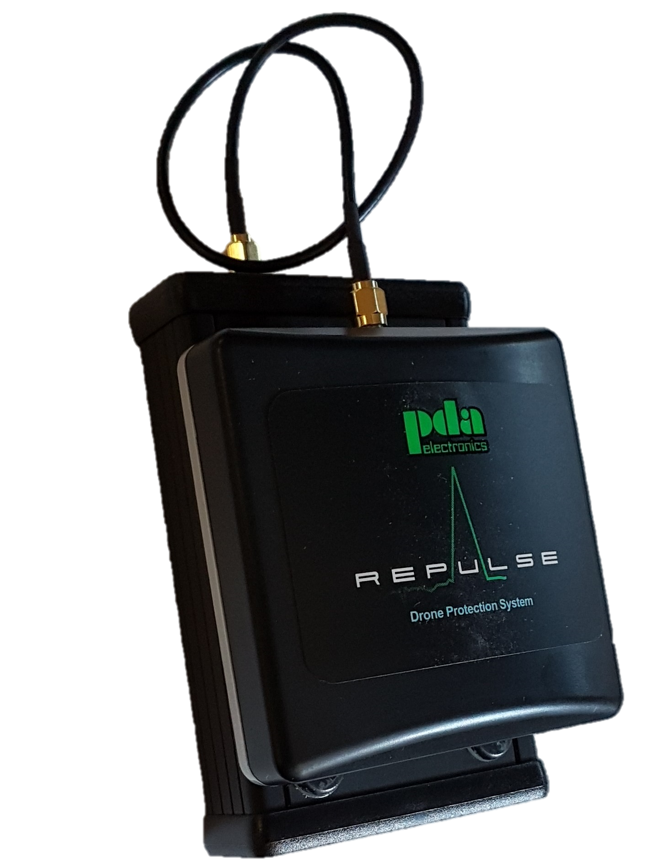
Protecting an aircraft in flight
Generally an approach speed of an airplane on landing is 175mph. With a Repulse® unit fitted in the front of an aircraft we can protect in front of it for approximately 20 seconds which is a good safety margin to repulse the drone and get it out of the way making the approach for landing safe.
Beam width approx. 1Km
Using a Repulse®24 system either in the nose or sitting on the dashboard of a airplane it can protect against a drone encroachment for a distance in excess of 1.5Km and a width of approximately 1Km.
Beam length in excess of 1.5Km

Slide 11
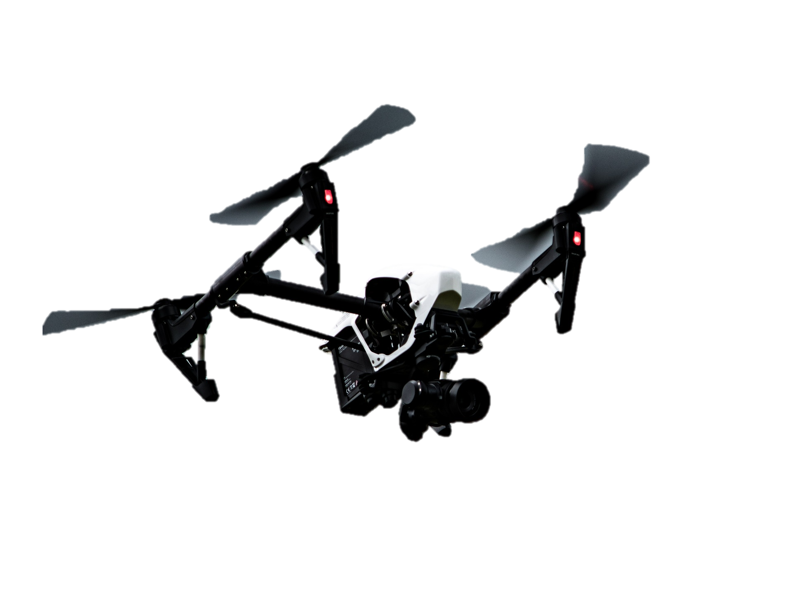
Protecting soldiers in the field.
By putting a Repulse®24 and/or Repulse®58 in a soldiers backpack the entire squad can be protected from spying or weaponized drones.
The unit without the small 6.8ah battery weighs only 350 grams and can fit into a side pocket and fix the antenna on the top of the backpack.
Protection in excess of 1.5Km

Slide 12
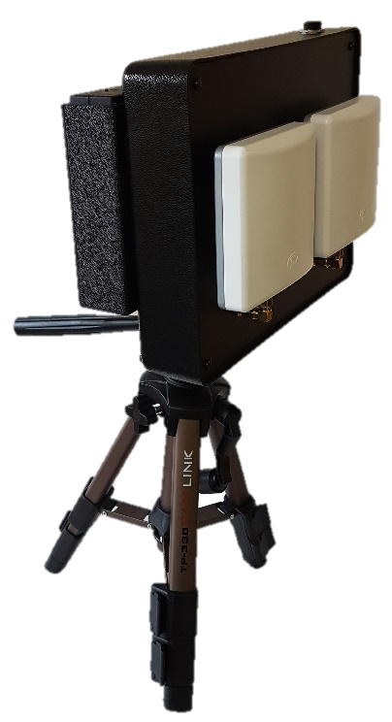
Range and Ratios of Repulse
Repulse has a range in excess of 1Km from the unit in line of sight conditions. It also has a range ratio in standard conditions of 5 : 1 (if flying from 1Km away you will only be able to fly 200m towards the Repulse system).
The ratio becomes lower the closer you are to the Repulse unit for example if you are 300m from the unit you may be able to fly 100m towards the unit.
Drone might fly 100m from a closer distance
Drone can only fly
200m Max. from 1Km away.
Repulse unit
200m
500m
1Km
Distance from Repulse unit
800m

Slide 13
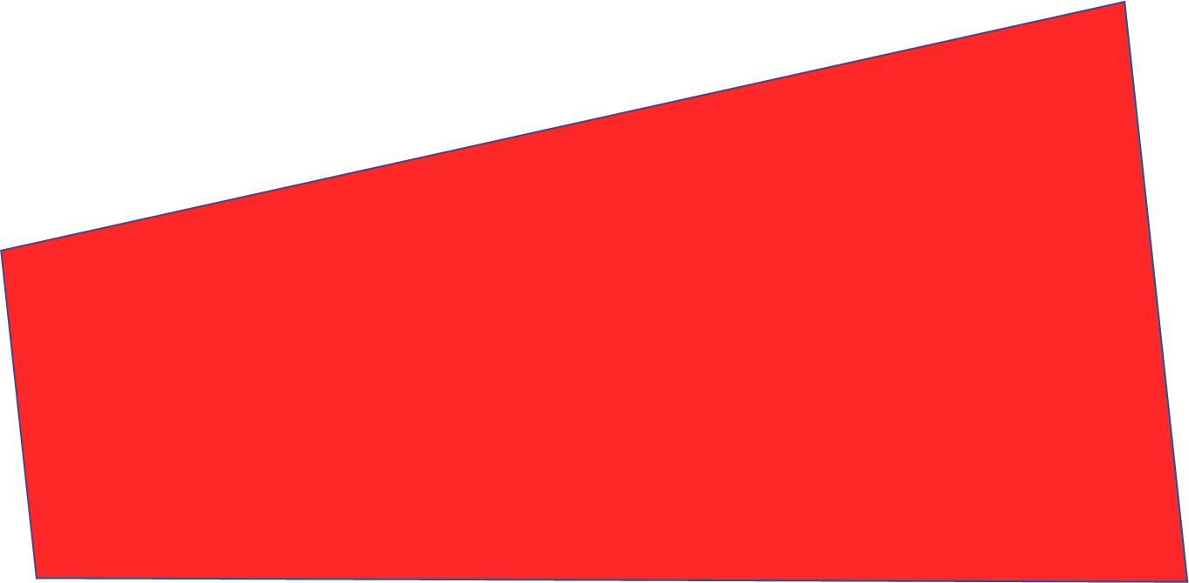
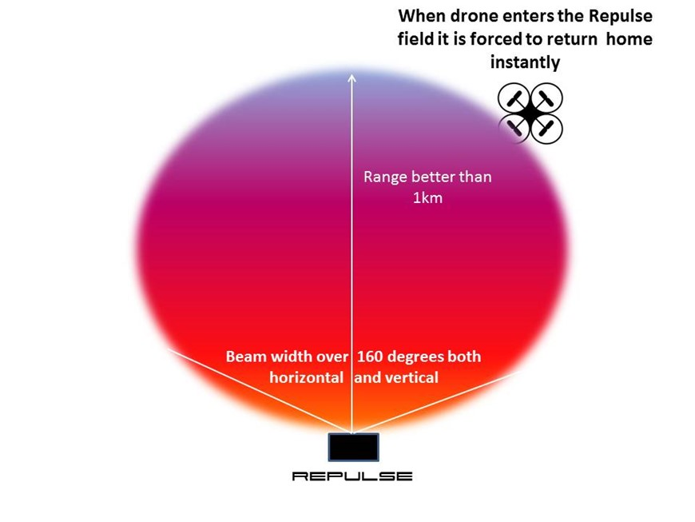
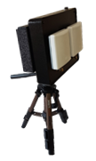
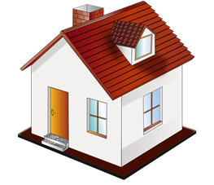
The Repulse® beam
With all Repulse signal outputs a beam is projected much like a torch light beam. Therefore if a building is in line of sight it will create a shadow in the beam pattern allowing a drone to be flown directly behind the building but as soon as it appears from behind the building Repulse will affect it.
Repulse beam
Where a drone will be affected
Shadow created by the building
Allowing a drone to fly.

Slide 14
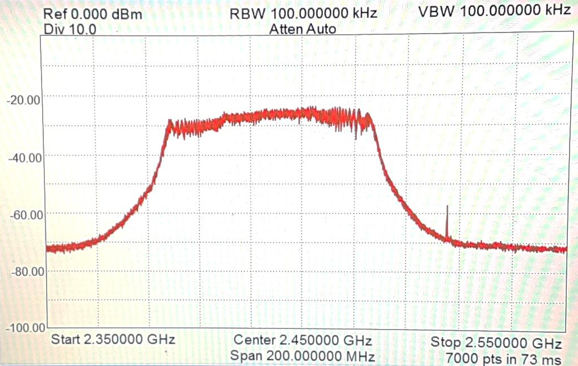
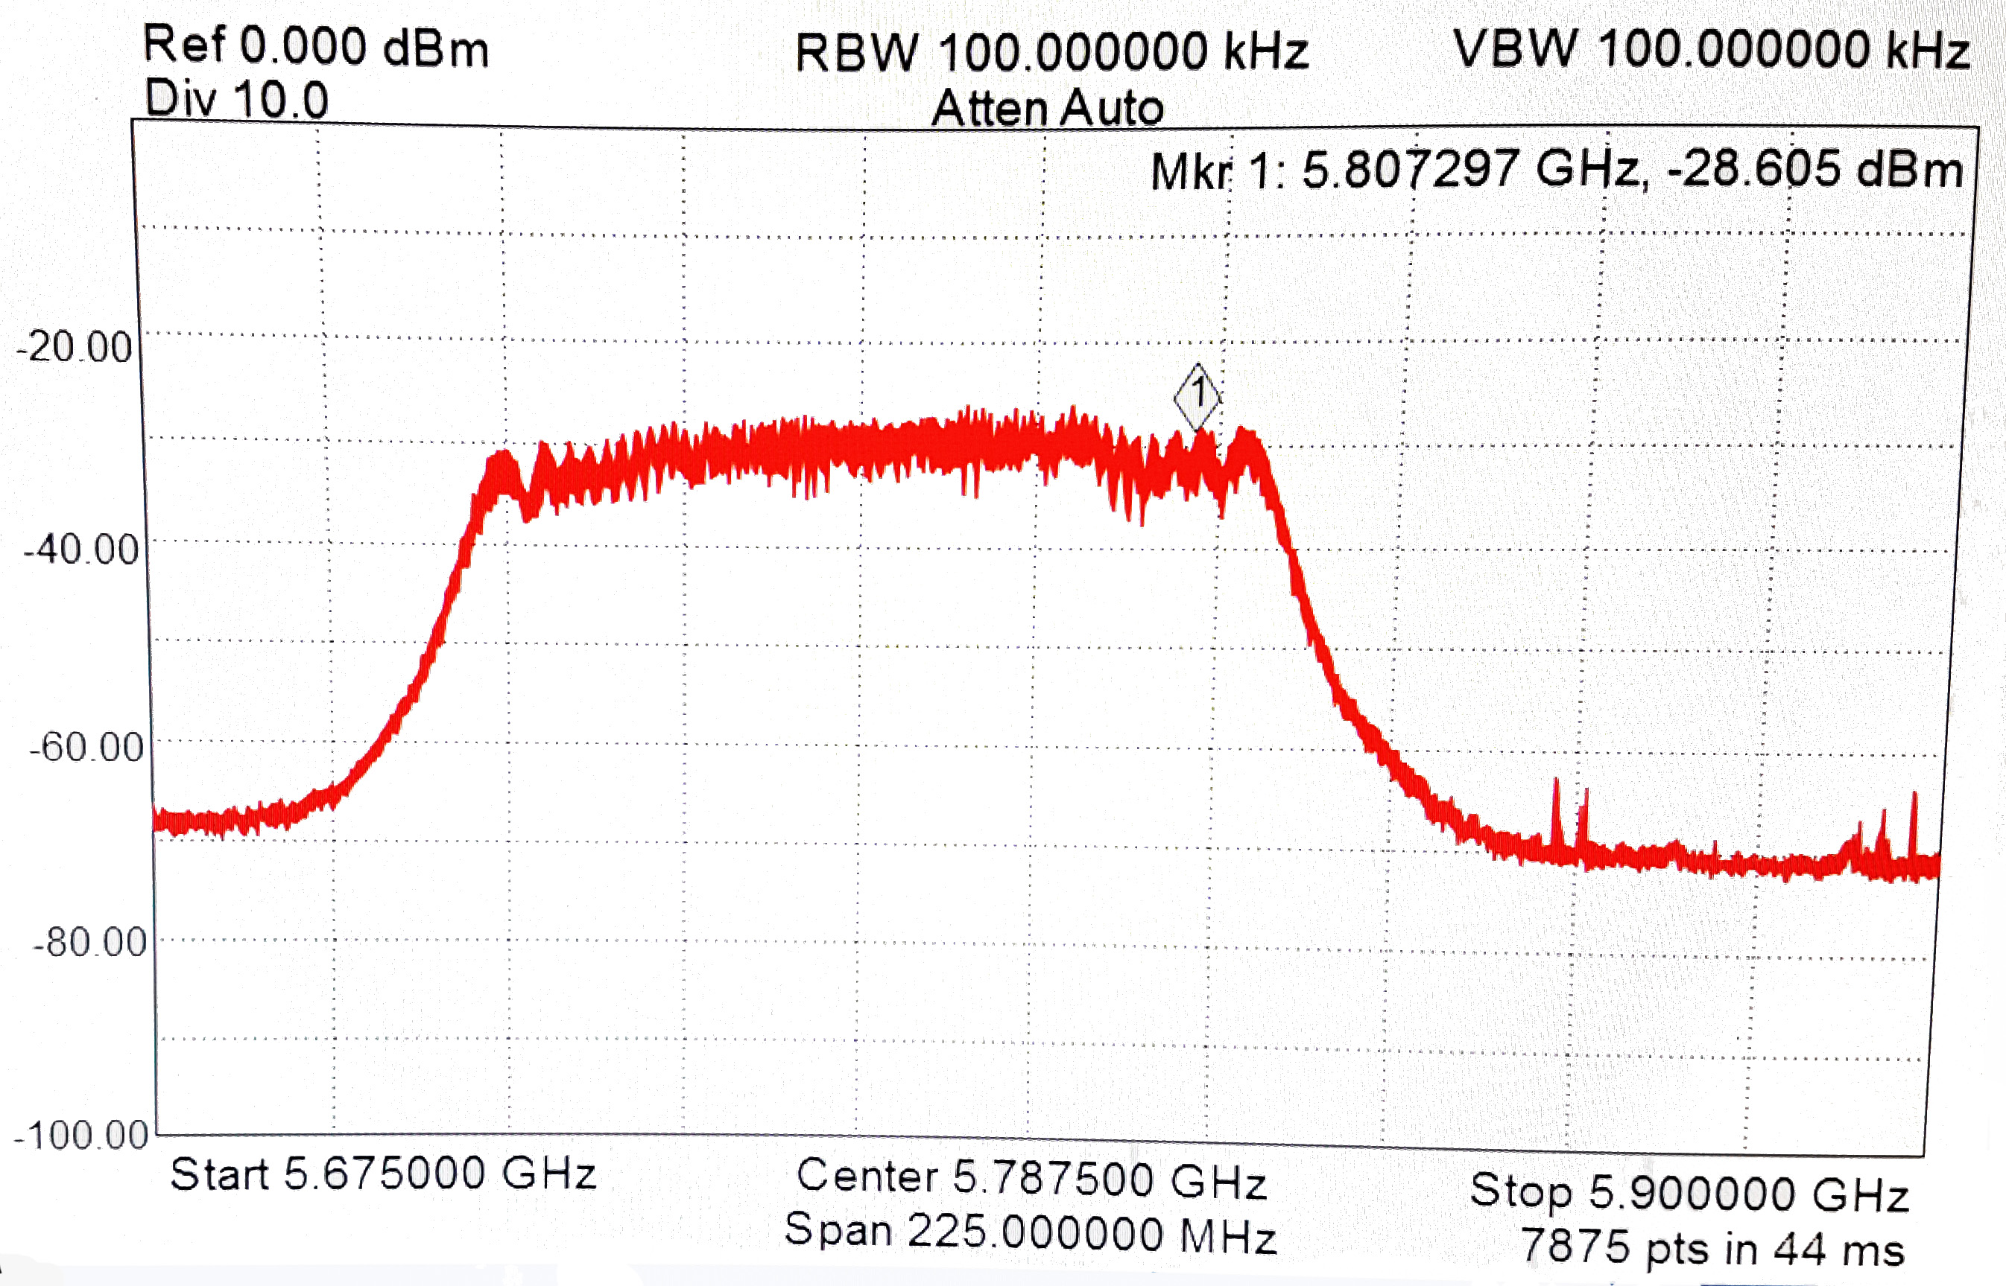
Antenna radiation plots
Output power as measured at 50cm from the unit
2.4 GHz
5.8 GHz

Slide 15
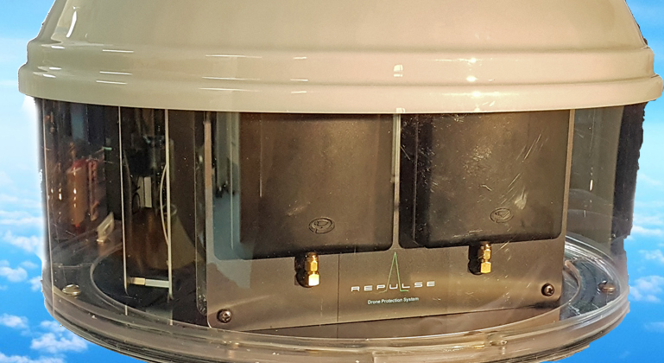
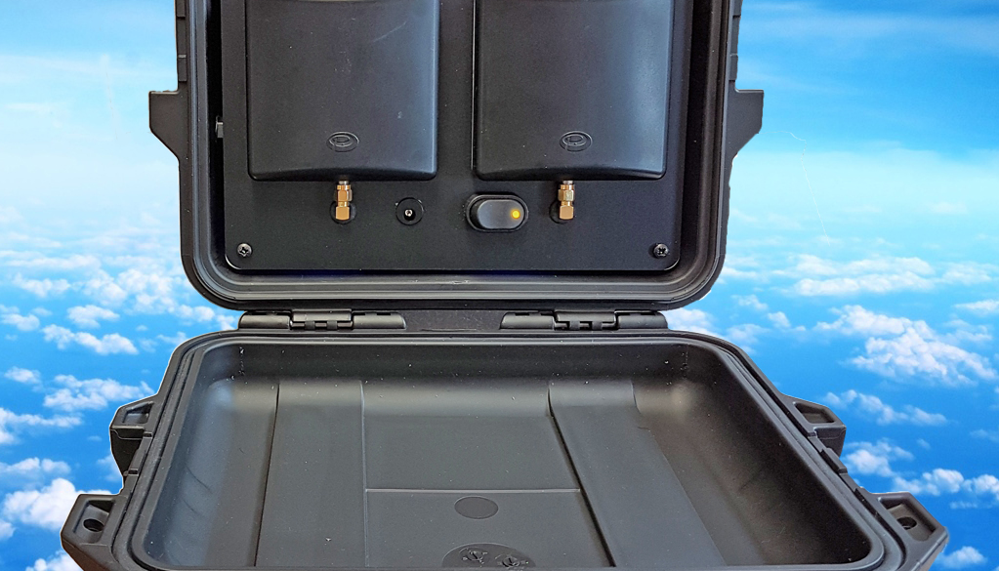
Technical spec
Frequency Range - 2400 – 2485 / 5725 – 5825 MHz
Patch Antenna
Beam Width - ±80° Horizontally & Vertically
Operating Range - In excess of 1km
Battery - 6800Ah Lithium-ion
Battery Operating - Approximately 4-6 hours (dependant on power setting)
Time
Total Current - 1.5 Amps at 12v DV
Average power - -30dBm = 1µW
Per Band measured at 15cm with Tx power set to +28dBm
Total Power - EIRP 4W / band
Output based on 1watt – antenna gain 6dBi

Slide 16
For more information.
Web: www.repulsedrones.com
Facebook: Repulse
Twitter: Repulse Drones

